Slide 1
Real Estate Trend in USA in last 10 years
-Sarita Inguava

Slide 2
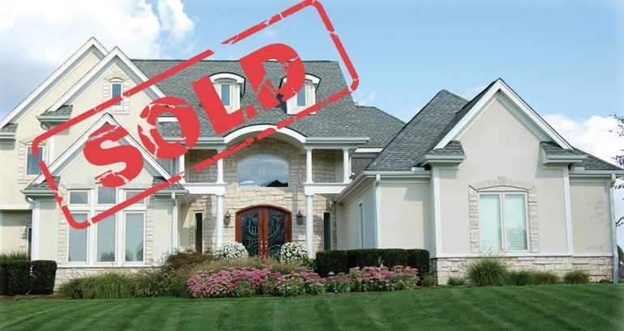
Dataset
-Dataset is from https://www.zillow.com/research/data/
-Contains aggregated data for all states and Metros of United States
Median Sale Prices
House Sale Counts
Price per sqft
Days On Market

Slide 3
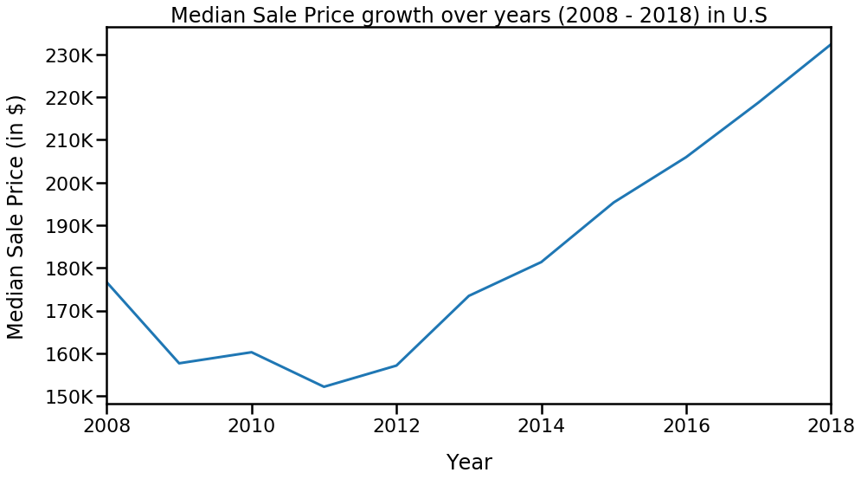
55% Increase from Sept 2011

Slide 4
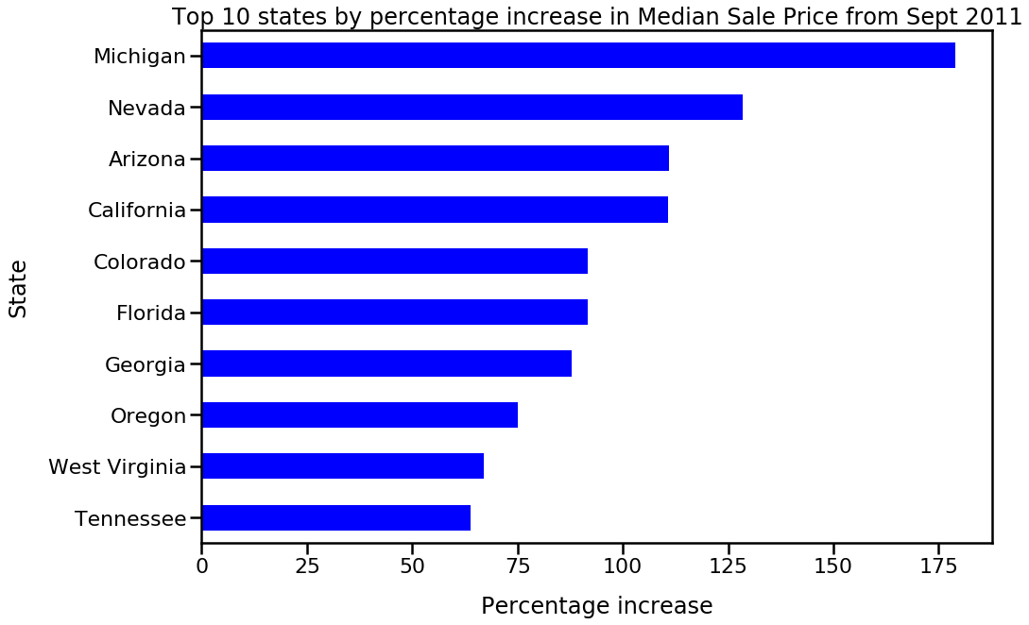
115 %

Slide 5
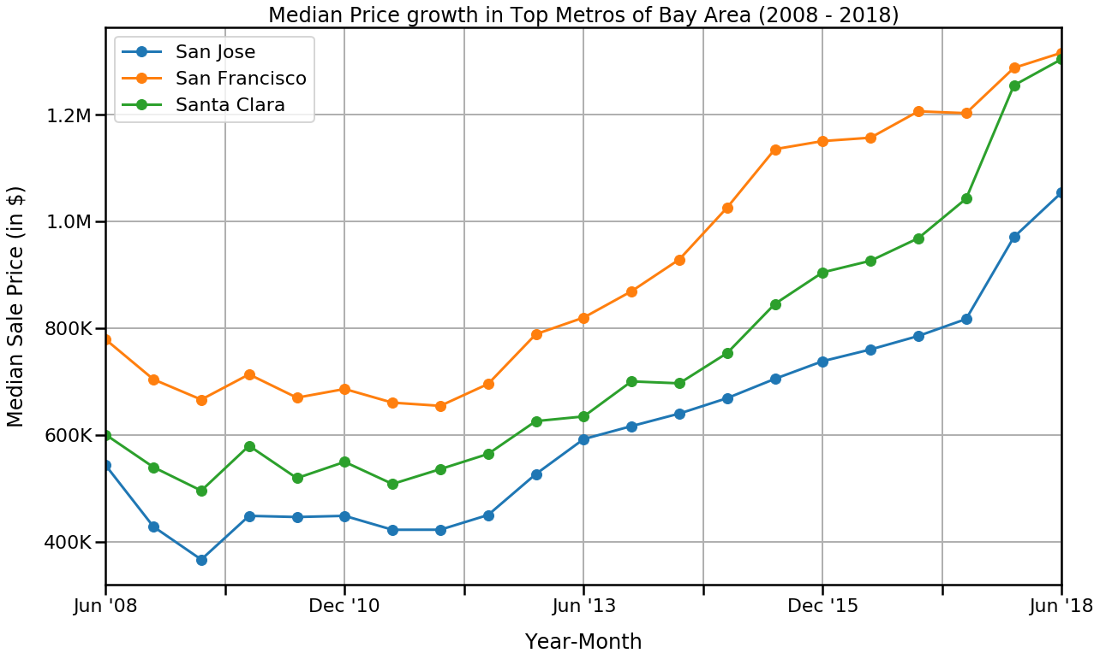
101%
156%
150%

Slide 6
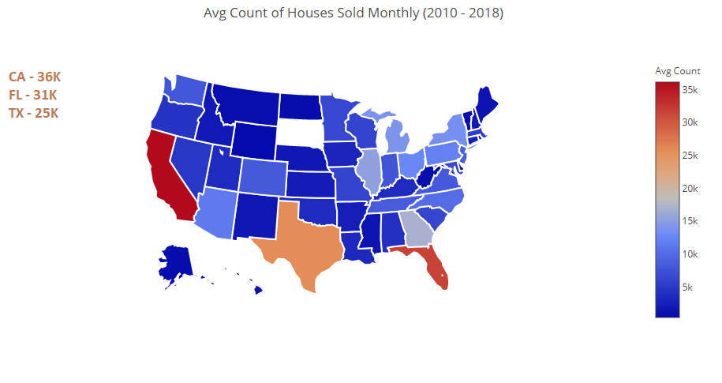

Slide 7
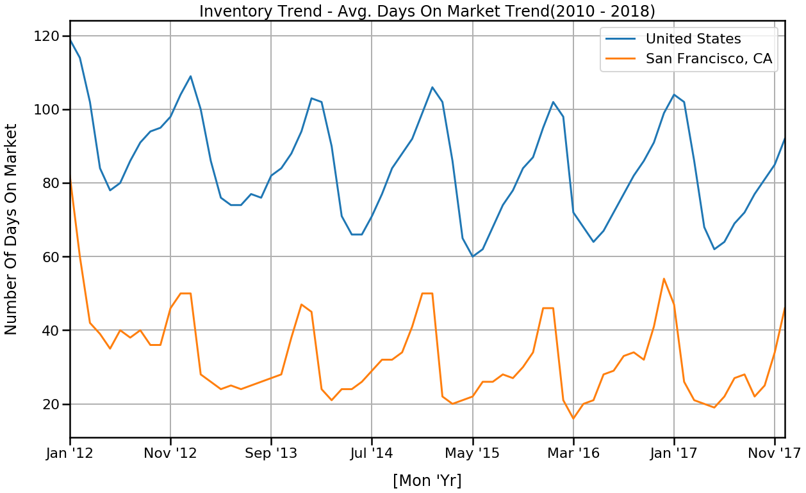

Slide 8
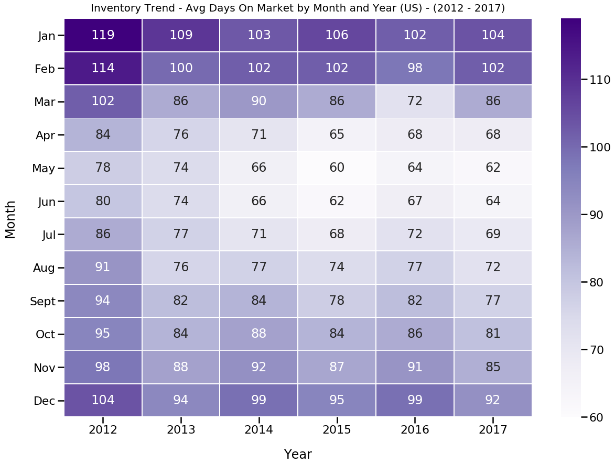

Slide 9
Future Improvements
Study the degree to which income growth leads to rising housing costs.
Research on the population in the cities and develop an affordability metric depending on the housing units available.

Slide 10
Thank You

